Slide 1
CREDIT CARD FRAUD DETECTION USING MACHINE LEARNING ALGORITHMS
NAME | REGISTER NUMBER
B.SAI CHARAN REDDY | 99210041146
N.V.SUNEEL KUMAR REDDY | 99210041597
B.V.SUDHARSHAN | 9910041454
RAJAN KUMAR MISRA | 99210041706
B.MANIDEEP REDDY | 99210041018
Guided by
Anitha Ponraj
Kalasalingam Academy of Research and
Education

Slide 2
Contents
Abstract
Introduction
Objective
motivation towards work
Literature survey
Proposed system
Work flow
Methodology
Result
Conclusion
References

Slide 3
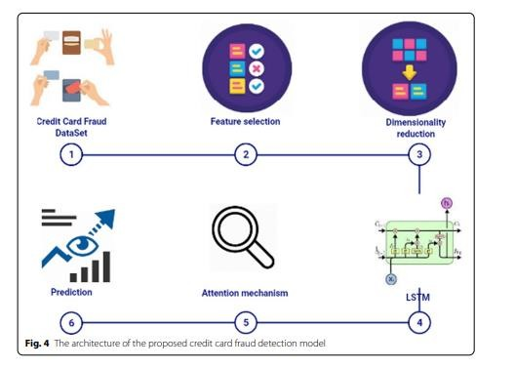
ABSTRACT
▶ Credit card fraud is a significant problem that financial institutions face, leading to financial losses and damage to the reputation of the organization. With the increase in the number of transactions, traditional methods of fraud detection are no longer sufficient.
▶ Machine learning algorithms have shown to be effective in detecting fraudulent transactions accurately. In this approach, data on credit card transactions is collected and preprocessed to extract meaningful features.
▶ according to a report published by the Reserve Bank of India (RBI) in March 2020, the number of reported cases of credit card fraud in India increased by 32.8% in 2019, with a total of 21,799 cases being reported. The report also noted that the amount involved in credit card fraud increased by 13.5% to Rs 684.8 crore (about $94.5 million) in 2019.
▶ Credit card fraud detection using machine learning is a promising solution that can help financial institutions prevent financial losses and protect their customers' interests.

Slide 4
Introduction
Credit card fraud is the act of using another person’s credit card to make purchases or request cash advances without the cardholder’s knowledge or consent.
These criminals may obtain the card itself through physical theft, though increasingly fraudsters are leveraging digital means to steal the credit card number and accompanying personal information to make illicit transactions. There is some overlap between identity theft and credit card theft. In fact, credit card theft is one of the most common forms of identity
theft. In such cases, a fraudster uses an individual’s personal information, which is often stolen as part of a cyberattack or data breach, to open a new account that the victim does not know about. This activity is considered both
identity fraud and credit card fraud

Slide 5
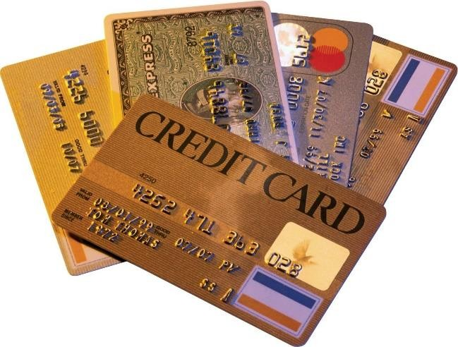
Types of credit card fraud
Credit card fraud falls into two basic categories: 1.Card present fraud
2.Card-not-present fraud

Slide 6
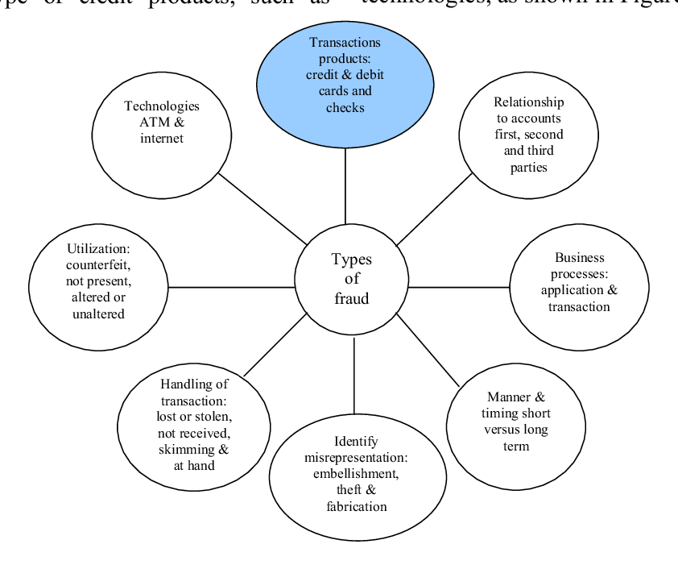
Types of credit card fraud

Slide 7
OBJECTIVE
▶ The objective of credit card fraud detection using machine learning is to develop an accurate and reliable system that can detect fraudulent transactions in real-time. The system should be able to flag suspicious transactions and block or subject them to further investigation.
▶ The scope of credit card fraud detection using machine learning includes:
▶ Collecting and Pre-processing Data
▶ Model Training
▶ Model Evaluation
▶ Model Deployment
▶ The scope of credit card fraud detection using machine learning also includes monitoring the performance of the system, updating the system as new data becomes available, and improving the system's accuracy and reliability over time. The ultimate goal of credit card fraud detection using machine learning is to prevent financial losses and protect the interests of financial institutions and their customers.

Slide 8

Motivation towards work
Credit card fraud is a significant problem that financial institutions face, leading to financial losses and damage to the reputation of the organization. With the increase in the number of transactions, traditional methods of fraud detection are no longer sufficient.
To reduce the fraud we detect where the frauds mostly done based on some attributes
This Photo by Unknown author is licensed under CC BY-SA-NC.

Slide 9
Literature survey
Author | Title | year | Description
Jemi Jeba & et al | Fraud Detection for Credit Card Transactions Using Random Forest Algorithm | 2021 | Credit card fraud might result in huge ﬁnancial losses. While look for the solutions for credit card frauds that are happening, machine learning techniques provide favorable solutions. The proposed system uses a random forest application in solving the problem and to attain more accuracy when compared to the other algorithms used till now. All the basic classiﬁers have the same weight but the random forest algorithm has relatively high and others have relatively low weights because of the randomization of bootstrap sampling of a making decision

Slide 10
Literature survey
Author | Title | year | Description
Devi Meenakshi& et al | CREDIT CARD FRAUD DETECTION USING RANDOM FOREST | 2019 | The project is mainly focused on credit card fraud detection in real world. A phenomenal growth in the number of credit card transactions, has recently led to a considerable rise in fraudulent activities. The purpose is to obtain goods without paying, or to obtain unauthorized funds from an account. Implementation of efficient fraud detection systems has become imperative for all credit card issuing banks to minimize their losses. One of the most crucial challenges in making the business is that neither the card nor the cardholder needs to be present when the purchase is being made.

Slide 11
Proposed system
We use the Random Forest to predict the fraud.
Credit card fraud detection is the collective term for the policies, tools, methodologies, and practices that credit card companies and financial institutions take to combat identity fraud and stop fraudulent transactions.

Slide 12
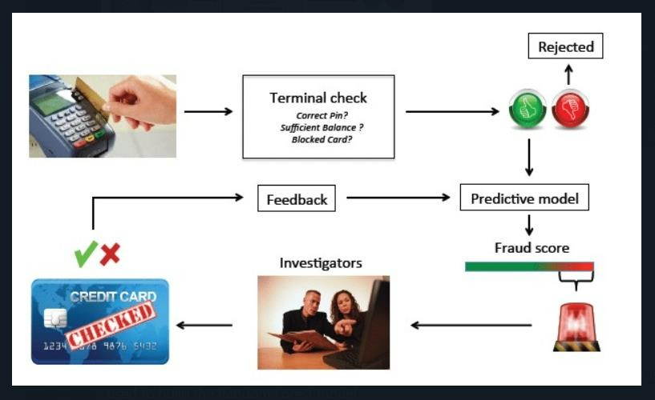
Proposed system
Card transactions are always unfamiliar when compared to previous transactions made the customer. This unfamiliarity is a very difficult problem in real-world when are called concept drift problems . Concept drift can be said as a variable that changes over time and in unforeseen ways. These variables cause a high imbalance in data. The main aim of our research is to overcome the problem of Concept drift to implement on real-world scenario.

Slide 13
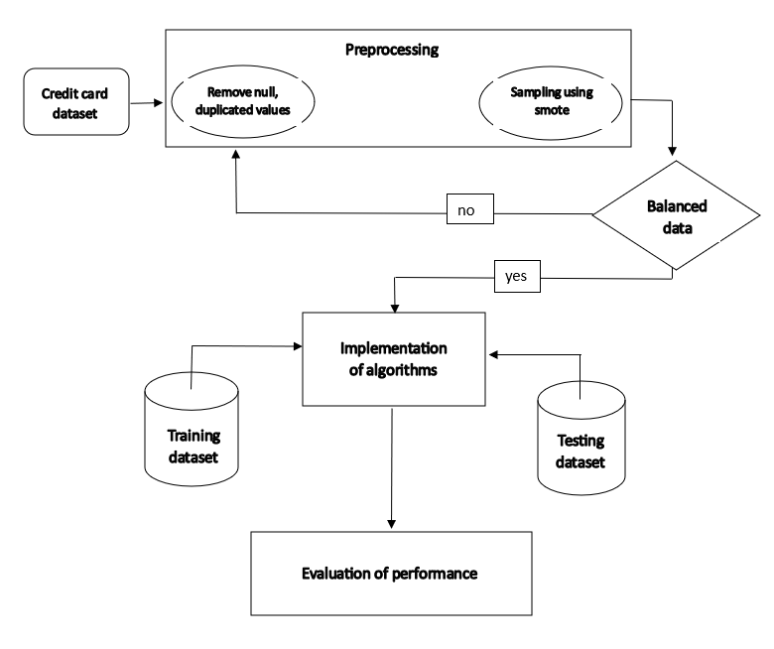
WORK FLOW

Slide 14
METHODOLOGY
Dataset Description:
Kaggle
time, class, and 28 PCA
Data Pre-processing :
removing null, duplicates
Standard scalar
Sampling
Smote()

Slide 15
Purchase history and other historical data : 1.Location
Device ID
IP address
Payment amount
Transaction information
Data collection is based on above attributes.

Slide 16
METHODOLOGY
3. models:
Logistic Regression
Decision Tree Classifier
Random Forest

Slide 17
RANDOM FOREST:
Random Forest is a popular machine learning algorithm used for both regression and classification tasks. It belongs to the family of ensemble learning methods, which means that it combines multiple weak learners (decision trees) to form a strong and more accurate predictor.
In a Random Forest algorithm, several decision trees are constructed on different subsets of the training data, and each tree is trained independently. During training, at each node in the tree, a random subset of the features is selected to determine the best split. The final prediction is made by aggregating the predictions of all the individual trees in the forest, using either the mean (for regression) or the mode (for classification) of the predictions.
The main advantages of Random Forest are its high accuracy, robustness to noise and overfitting, and ability to handle high-dimensional data. It is widely used in various applications, including finance, biology, and image recognition.

Slide 18
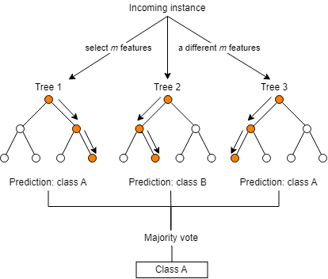
RANDOM FOREST GRAPH

Slide 19
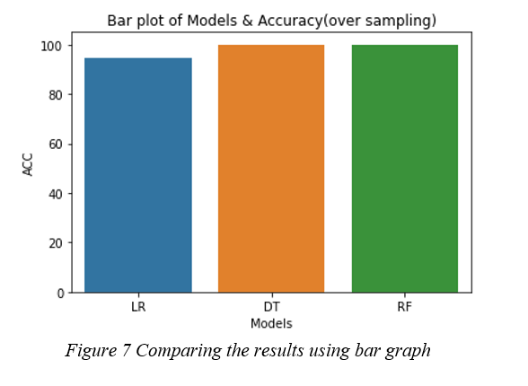
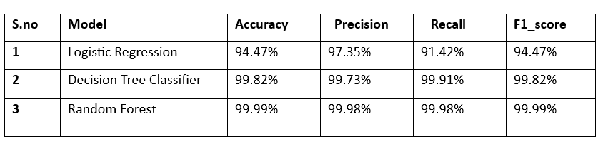
RESULT

Slide 20
CONCLUSION
▶ In this study, we examined a range of machine learning classification methods, including Logistic Regression, Random Forest, Decision Tree Classifier, which express accuracy in identifying fraudulent transactions and reducing the number of false alarms. The likelihood of fraudulent transactions can be predicted shortly after credit card transactions if these algorithms are integrated into bank credit card fraud detection systems. Additionally, a number of anti-fraud methods can be implemented to lower risks and protect banks from significant losses. Recall, accuracy, f1-score, and precision are used to assess the performance of the classification models. We found that the random forest classifier methodology is superior to the other classification methods with 99.99% of accuracy after comparing all of them. The accuracies of other models are 94.47% and 99.82%.

Slide 21
REFERENCES
▶ [1] Jiang, Changjun et al. “Credit Card Fraud Detection: A Novel Approach Using Aggregation Strategy and Feedback Mechanism.” IEEE Internet of Things Journal 5 (2018): 3637-3647.
▶ [2]Randhawa, Kuldeep, et al. “Credit Card Fraud Detection Using AdaBoost and Majority Voting.” IEEE Access, vol. 6, 2018, pp. 14277–14284., doi:10.1109/access.2018.2806420.
▶ [3]Xuan, Shiyang, et al. “Random Forest for Credit Card Fraud Detection.” 2018 IEEE 15th International Conference on Networking, Sensing and Control (ICNSC), 2018, doi:10.1109/icnsc.2018.8361343.
▶ [4] Wang Xi. Some Ideas about Credit Card Fraud Prediction China Trial. Apr.
2008, pp. 74-75.

